Slide 1





Complete Selenium Automation Engineer Bootcamp: Go from Zero to Hero

Slide 2
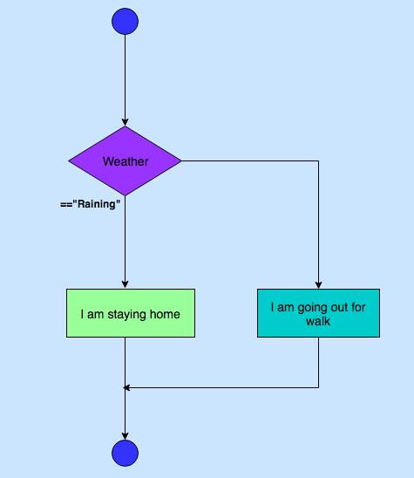
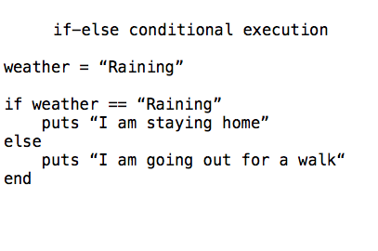
Conditional Execution – If-else

Slide 3
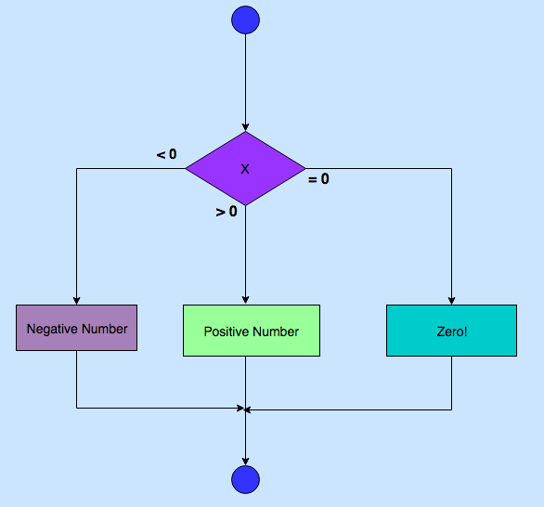
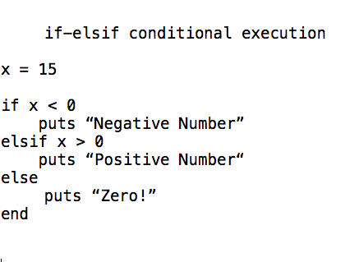
Conditional Execution – If –elsif- else

Slide 4
Conditional Expressions
 | Condition1 | Condition2 | Result
&& | True | True | True
&& | True | False | False
&& | False | True | False
||(OR) | True | False | True
||(OR) | False | True | True
== | Equal to
!= | Not Equal to

Slide 5
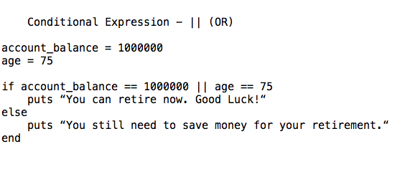
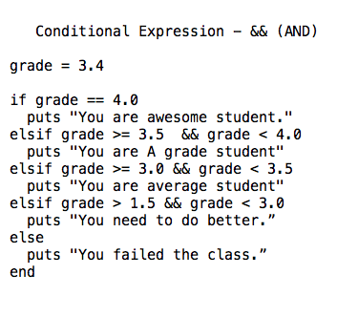
Conditional Expressions

